Slide 1
AZ-700T00A Module 05: Load balancing HTTP(S) traffic in Azure

Slide 2
Module Overview
Lesson 01: Design Azure Application Gateway
Lesson 02: Configure Azure Application Gateway
Lesson 03: Exercice: deploy Azure Application Gateway
Lesson 04: Design and configure Azure Front Door
Lesson 05: Exercise: create a Front Door for highly available web application using the Azure portal
Notes:
Design and Implement Routing (25–30%)
Design and implement Azure Application Gateway
• recommend Azure Application Gateway deployment options
• choose between manual and autoscale
• create a back-end pool
• configure health probes
• configure listeners
• configure routing rules
• configure HTTP settings
• configure Transport Layer Security (TLS)
• configure rewrite policies
Implement Azure Front Door
• choose an Azure Front Door SKU
• configure health probes, including customization of HTTP response codes
• configure SSL termination and end-to-end SSL encryption
• configure multisite listeners
• configure back-end targets
• configure routing rules, including redirection rules

Slide 3
Lesson 01: Design Azure Application Gateway

Slide 4
Design Azure Application Gateway overview
Application Gateway features
Determine Application Gateway Routing
Choosing an Azure App Gateway SKU
Application Gateway configuration planning
Review

Slide 5
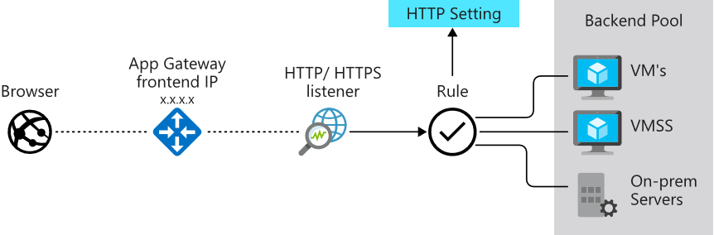
Application Gateway features
Manages web app requests
Routes traffic to a pool of web servers based on the URL of a request
The web servers can be Azure virtual machines, Azure virtual machine scale sets, Azure App Service, and even on-premises servers
Notes:
Application Gateway configuration overview - https://docs.microsoft.com/en-us/azure/application-gateway/configuration-overview
Support for the HTTP, HTTPS, HTTP/2 and WebSocket protocols.
A web application firewall to protect against web application vulnerabilities.
End-to-end request encryption.
Autoscaling, to dynamically adjust capacity as your web traffic load change.
Redirection: Redirection can be used to another site, or from HTTP to HTTPS.
Rewrite HTTP headers: HTTP headers allow the client and server to pass parameter information with the request or the response.
Custom error pages: Application Gateway allows you to create custom error pages instead of displaying default error pages. You can use your own branding and layout using a custom error page.

Slide 6
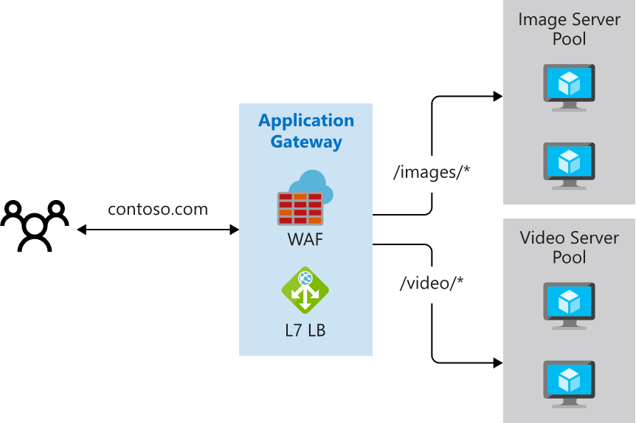
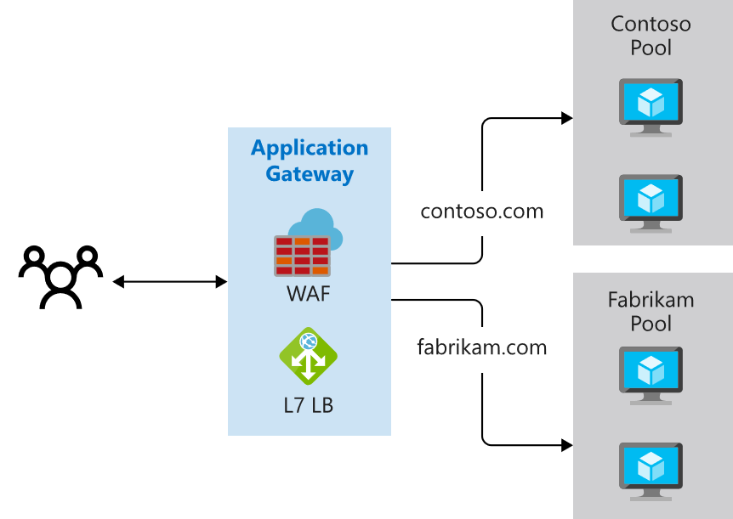
Determine Application Gateway Routing
Path-based routing
Multiple-site routing
Notes:
QuickStart: Direct web traffic with Azure Application Gateway - Azure portal - https://docs.microsoft.com/en-us/azure/application-gateway/quick-create-portal
Path-based routing sends requests with different URL paths different pools of back-end servers. For example, you could direct requests with the path /video/* to a back-end pool containing servers that are optimized to handle video streaming, and direct /images/* requests to a pool of servers that handle image retrieval.
Multiple site routing configures more than one web application on the same application gateway instance. In a multi-site configuration, you register multiple DNS names (CNAMEs) for the IP address of the Application Gateway, specifying the name of each site. Application Gateway uses separate listeners to wait for requests for each site. Each listener passes the request to a different rule, which can route the requests to servers in a different back-end pool. For example, you could direct all requests for http://contoso.com to servers in one back-end pool, and requests for http://fabrikam.com to another back-end pool. The following diagram shows this configuration.

Slide 7
Choosing an Azure App Gateway SKU
Application Gateway Standard (V2) can be configured for autoscaling or fixed size deployments. The v2 SKU doesn't offer different instance sizes
For a complete list of application gateway limits, see Application Gateway service limits
The Application Gateway Standard (V1) is offered in three sizes: Small, Medium, and Large. Small instance sizes are intended for development and testing scenarios.
Average back-end page response size | Small | Medium | Large
6 KB | 7.5 Mbps | 13 Mbps | 50 Mbps
100 KB | 35 Mbps | 100 Mbps | 200 Mbps
Notes:
Azure subscription limits and quotas - Azure Resource Manager | Microsoft Docs
Application Gateway is available under a Standard_v2 SKU. Web Application Firewall (WAF) is available under a WAF_v2 SKU. The v2 SKU offers performance enhancements and adds support for critical new features like autoscaling, zone redundancy, and support for static VIPs. Existing features under the Standard and WAF SKU continue to be supported in the new v2 SKU.
The new v2 SKU includes the following enhancements:
Autoscaling: Application Gateway or WAF deployments under the autoscaling SKU can scale out or in based on changing traffic load patterns. Autoscaling also removes the requirement to choose a deployment size or instance count during provisioning. This SKU offers true elasticity. In the Standard_v2 and WAF_v2 SKU, Application Gateway can operate both in fixed capacity (autoscaling disabled) and in autoscaling enabled mode. Fixed capacity mode is useful for scenarios with consistent and predictable workloads. Autoscaling mode is beneficial in applications that see variance in application traffic.
Zone redundancy: An Application Gateway or WAF deployment can span multiple Availability Zones, removing the need to provision separate Application Gateway instances in each zone with a Traffic Manager. You can choose a single zone or multiple zones where Application Gateway instances are deployed, which makes it more resilient to zone failure. The backend pool for applications can be similarly distributed across availability zones.
Not all Azure regions support availability zones yet.
Static VIP: Application Gateway v2 SKU supports the static VIP type exclusively. This ensures that the VIP associated with the application gateway doesn't change for the lifecycle of the deployment, even after a restart. There isn't a static VIP in v1, so you must use the application gateway URL instead of the IP address for domain name routing to App Services via the application gateway.
Header Rewrite: Application Gateway allows you to add, remove, or update HTTP request and response headers with v2 SKU.
Key Vault Integration: Application Gateway v2 supports integration with Key Vault for server certificates that are attached to HTTPS enabled listeners.
Azure Kubernetes Service Ingress Controller: The Application Gateway v2 Ingress Controller allows the Azure Application Gateway to be used as the ingress for an Azure Kubernetes Service (AKS) known as AKS Cluster.
Performance enhancements: The v2 SKU offers up to 5X better TLS offload performance as compared to the Standard/WAF SKU.
Faster deployment and update time: The v2 SKU provides faster deployment and update time as compared to Standard/WAF SKU. This also includes WAF configuration changes.

Slide 8
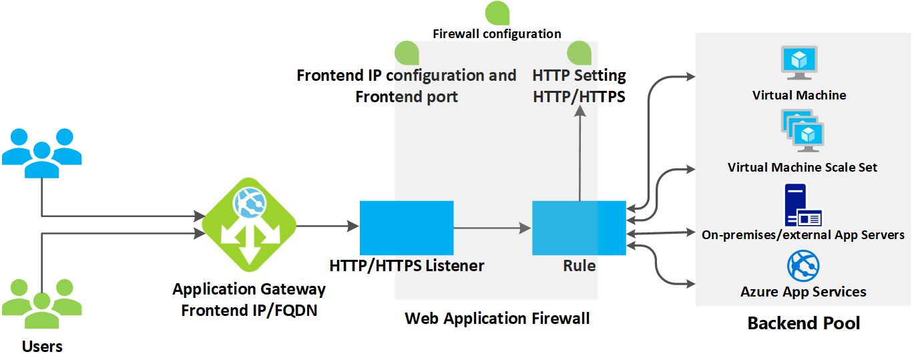
Application Gateway configuration planning
Notes:
Azure Application Gateway consists of several components that you can configure in various ways for different scenarios. Let's review what components you need to consider before configuration:
Infrastructure
The Application Gateway infrastructure includes the virtual network, subnets, network security groups, and user defined routes.
Front-end IP address
You can configure the application gateway to have a public IP address, a private IP address, or both. A public IP is required when you host a back end that clients must access over the Internet via an Internet-facing virtual IP (VIP).
Listeners
A listener is a logical entity that checks for incoming connection requests by using the port, protocol, host, and IP address. When you configure the listener, you must enter values for these that match the corresponding values in the incoming request on the gateway.
Request routing rules
When you create an application gateway by using the Azure portal, you create a default rule (rule1). This rule binds the default listener (appGatewayHttpListener) with the default back-end pool (appGatewayBackendPool) and the default back-end HTTP settings (appGatewayBackendHttpSettings). After you create the gateway, you can edit the settings of the default rule or create new rules.
HTTP settings
The application gateway routes traffic to the back-end servers by using the configuration that you specify here. After you create an HTTP setting, you must associate it with one or more request-routing rules.
Back-end pool
You can point a back-end pool to four types of backend members: a specific virtual machine, a virtual machine scale set, an IP address/FQDN, or an app service.
After you create a back-end pool, you must associate it with one or more request-routing rules. You must also configure health probes for each back-end pool on your application gateway. When a request-routing rule condition is met, the application gateway forwards the traffic to the healthy servers (as determined by the health probes) in the corresponding back-end pool.
Health probes
An application gateway monitors the health of all resources in its back end by default. But we strongly recommend that you create a custom probe for each back-end HTTP setting to get greater control over health monitoring.

Slide 9
Summary – Design Azure Application Gateway
Check your knowledge
Microsoft Learn Modules (docs.microsoft.com/Learn)
What is Azure Application Gateway | Microsoft Docs
Load balance your web service traffic with Application Gateway - Learn | Microsoft Docs

Slide 10
Lesson 02: Configure Azure Application Gateway

Slide 11
Configure Azure Application Gateway overview
Configure Application Gateway
Associated back-end pool
Configure Health Probes
Configure URL-based routing
Configure Listeners
Configure rewrite policies
Redirection Overview
Demonstration
Application Gateway Request routing rules
Review

Slide 12
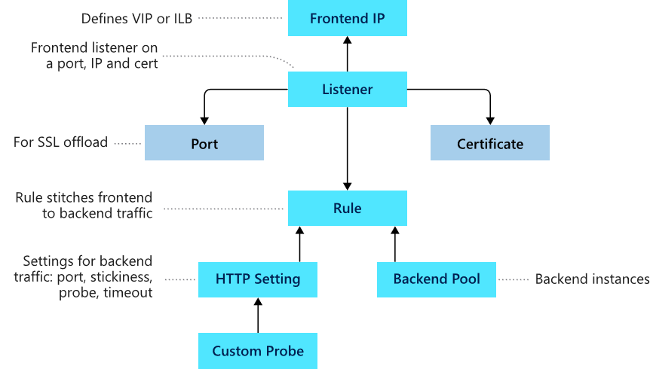
Configure Application Gateway
Frontend IP
Listeners
Routing rules
Backend pools
Web application firewall (optional)
Health probes
Notes:
Load balance your web service traffic with Application Gateway - https://docs.microsoft.com/learn/modules/load-balance-web-traffic-with-application-gateway/
Frontend configuration
For the Application Gateway v2 SKU, there must be a public frontend IP configuration. You can still have both a Public and a Private frontend IP configuration, but Private only frontend IP configuration (Only ILB mode) is currently not enabled for the v2 SKU.
You can configure the Frontend IP to be Public or Private as per your use case.
Backend configuration
The backend pool is used to route requests to the backend servers that serve the request. Backend pools can be composed of NICs, virtual machine scale sets, public IP addresses, internal IP addresses, fully qualified domain names (FQDN), and multi-tenant back-ends like Azure App Service. You can create an empty backend pool with your application gateway and then add backend targets to the backend pool.

Slide 13
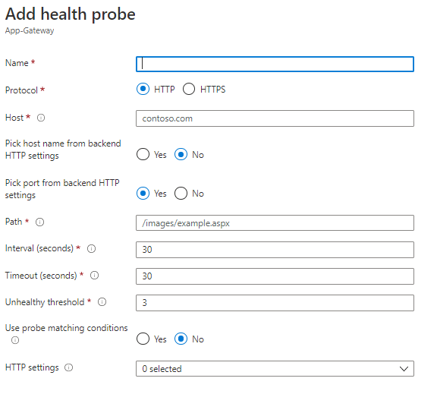
Configure health probes
Default health probe
Custom health probe
Probe matching
Notes:
Azure Application Gateway by default monitors the health of all resources in its back-end pool and automatically removes any resource considered unhealthy from the pool. Application Gateway continues to monitor the unhealthy instances and adds them back to the healthy back-end pool once they become available and respond to health probes. By default, Application gateway sends the health probes with the same port that is defined in the back-end HTTP settings. A custom probe port can be configured using a custom health probe.
The source IP address Application Gateway uses for health probes depends on the backend pool:
If the server address in the backend pool is a public endpoint, then the source address is the application gateway's frontend public IP address.
If the server address in the backend pool is a private endpoint, then the source IP address is from the application gateway subnet's private IP address space.
Default health probe
An application gateway automatically configures a default health probe when you don't set up any custom probe configurations. The monitoring behavior works by making an HTTP GET request to the IP addresses or FQDN configured in the back-end pool. For default probes if the backend http settings are configured for HTTPS, the probe uses HTTPS to test health of the backend servers.
For example: You configure your application gateway to use back-end servers A, B, and C to receive HTTP network traffic on port 80. The default health monitoring tests the three servers every 30 seconds for a healthy HTTP response with a 30 second timeout for each request. A healthy HTTP response has a status code between 200 and 399. In this case, the HTTP GET request for the health probe will look like http://127.0.0.1/.
If the default probe check fails for server A, the application gateway stops forwarding requests to this server. The default probe continues to check for server A every 30 seconds. When server A responds successfully to one request from a default health probe, application gateway starts forwarding the requests to the server again.
appgatewayprobe

Slide 14
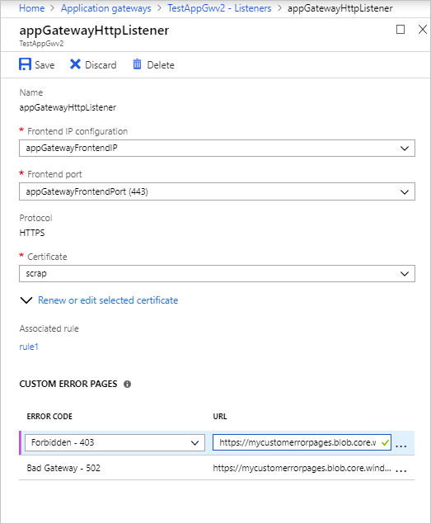
Configure listeners
Basic or Multi Site
Order of Processing Listeners
Frontend IP address
Frontend Port
Protocol HTTP or HTTPS

Slide 15
Redirection overview
Global redirection: Redirects from one listener to another listener on the gateway. This enables HTTP to HTTPS redirection on a site
The following types of redirection are supported:
301 Permanent Redirect
302 Found
303 See Other
307 Temporary Redirect
Path-based redirection: Enables HTTP to HTTPS redirection only on a specific site area, for example a shopping cart area denoted by /cart/*.
Redirect to external site: Requires a new redirect configuration object, which specifies the target listener or external site to which redirection is desired

Slide 16
Application Gateway Request routing rules
Rule Types:
Basic
Path-based
Order of processing rules
For the v1 and v2 SKU, pattern matching of incoming requests is processed in the order that the paths are listed in the URL path map of the path-based rule.
Associated listener
Associate a listener to the rule so that the request-routing rule that's associated with the listener is evaluated to determine the back-end pool to route the request to.
Associated back-end pool
basic rule: only one back-end pool is allowed. All requests on the associated listener are forwarded to that back-end pool.
path-based rule: add multiple back-end pools that correspond to each URL path. The requests that match the URL path that's entered are forwarded to the corresponding back-end pool.
Notes:
When you create an application gateway using the Azure portal, you create a default rule (rule1). This rule binds the default listener (appGatewayHttpListener) with the default back-end pool (appGatewayBackendPool) and the default back-end HTTP settings (appGatewayBackendHttpSettings). After you create the gateway, you can edit the settings of the default rule or create new rules.
Rule types:
Basic forwards all requests on the associated listener (for example, blog.contoso.com/*) to a single back-end pool.
Path-based routes requests from specific URL paths to specific back-end pools.

Slide 17
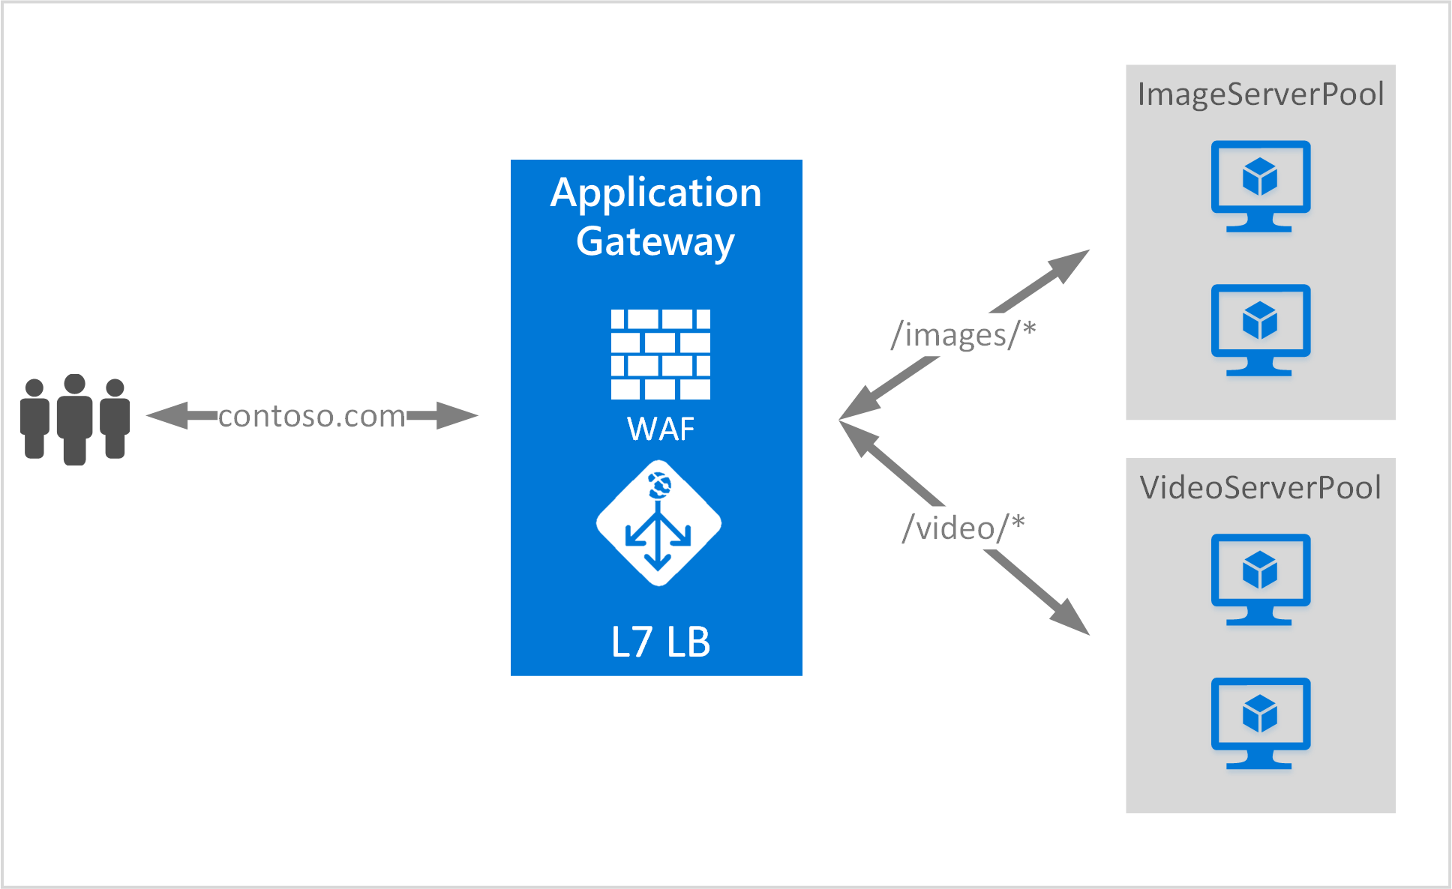
Configure URL Path-based routing
URL Path Based Routing allows you to route traffic to back-end server pools based on URL Paths of the request
Notes:
URL Path Based Routing allows you to route traffic to back-end server pools based on URL Paths of the request.
One of the scenarios is to route requests for different content types to different backend server pools.
In the following example, Application Gateway is serving traffic for contoso.com from three back-end server pools for example: VideoServerPool, ImageServerPool, and DefaultServerPool.
https://docs.microsoft.com/en-us/azure/application-gateway/features

Slide 18
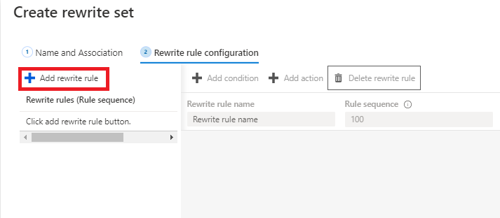
Configure rewrite policies
A rewrite rule set contains:
Request routing rule association
Rewrite Condition
Rewrite type
Rewriting request headers
Rewriting response headers
Rewriting URL components:
URL path
URL Query String
Re-evaluate path map
Notes:
Application Gateway allows you to rewrite selected content of requests and responses. With this feature, you can translate URLs, query string parameters as well as modify request and response headers. It also allows you to add conditions to ensure that the URL or the specified headers are rewritten only when certain conditions are met. These conditions are based on the request and response information.
HTTP header and URL rewrite features are only available for the Application Gateway v2 SKU.
configure a rewrite rule, you need to create a rewrite rule set and add the rewrite rule configuration in it.
A rewrite rule set contains:
Request routing rule association: The rewrite configuration is associated to the source listener via the routing rule. When you use a basic routing rule, the rewrite configuration is associated with a source listener and is a global header rewrite. When you use a path-based routing rule, the rewrite configuration is defined on the URL path map. In that case, it applies only to the specific path area of a site. You can create multiple rewrite sets and apply each rewrite set to multiple listeners. But you can apply only one rewrite set to a specific listener.
Rewrite Condition: It is an optional configuration. Rewrite conditions evaluate the content of the HTTP(S) requests and responses. The rewrite action will occur if the HTTP(S) request or response matches the rewrite condition. If you associate more than one condition with an action, the action occurs only when all the conditions are met. In other words, the operation is a logical AND operation.
Rewrite type: There are 3 types of rewrites available:
Rewriting request headers
Rewriting response headers
Rewriting URL components
URL path: The value to which the path is to be rewritten to.
URL Query String: The value to which the query string is to be rewritten to.
Re-evaluate path map: Used to determine whether the URL path map is to be re-evaluated or not. If kept unchecked, the original URL path will be used to match the path-pattern in the URL path map. If set to true, the URL path map will be re-evaluated to check the match with the rewritten path. Enabling this switch helps in routing the request to a different backend pool post rewrite.

Slide 19
Demo
Create an application gateway
Add backend targets
Test the application gateway
Notes:
Create an application gateway
Quickstart: Direct web traffic using the portal - Azure Application Gateway | Microsoft Docs

Slide 20
Summary – Configure Azure Application Gateway
Check your knowledge
Microsoft Learn Modules (docs.microsoft.com/Learn)
Azure Application Gateway documentation | Microsoft Docs
What is Azure Application Gateway | Microsoft Docs
Notes:
Learn - https://docs.microsoft.com/en-us/learn/browse/

Slide 21
Lesson 03: Exercise: deploy Azure Application Gateway

Slide 22
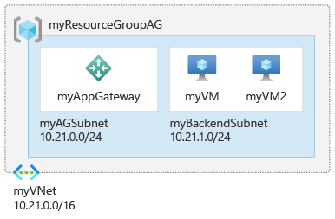
Exercise: deploy Azure Application Gateway
Task 1: Create an application gateway
Task 2: Add backend targets
Task 3: Add backend servers to backend pool
Task 4: Test the application gateway
Notes:
AZ-700-Designing-and-Implementing-Microsoft-Azure-Networking-Solutions/4-exercise-deploy-azure-application-gateway.md at master · MicrosoftLearning/AZ-700-Designing-and-Implementing-Microsoft-Azure-Networking-Solutions (github.com)

Slide 23
Summary – deploy Azure Application Gateway
Check your knowledge
Microsoft Learn Modules (docs.microsoft.com/Learn)
What is Azure Application Gateway | Microsoft Docs
Quickstart: Direct web traffic using the portal - Azure Application Gateway | Microsoft Docs

Slide 24
Lesson 04: Design and configure Azure Front Door

Slide 25
Design and configure Azure Front Door overview
What is Azure Front Door
Configure health probes
Azure Front Door Standard and Premium
Secure Front Door with SSL and end-to-end SSL encryption
Create a Front Door in the Azure portal
Demo
Configure routing and redirection rules
Review
Configure back-end targets
Notes:
Implement Azure Front Door
• choose an Azure Front Door SKU
• configure health probes, including customization of HTTP response codes
• configure SSL termination and end-to-end SSL encryption
• configure multisite listeners
• configure back-end targets
• configure routing rules, including redirection rules

Slide 26
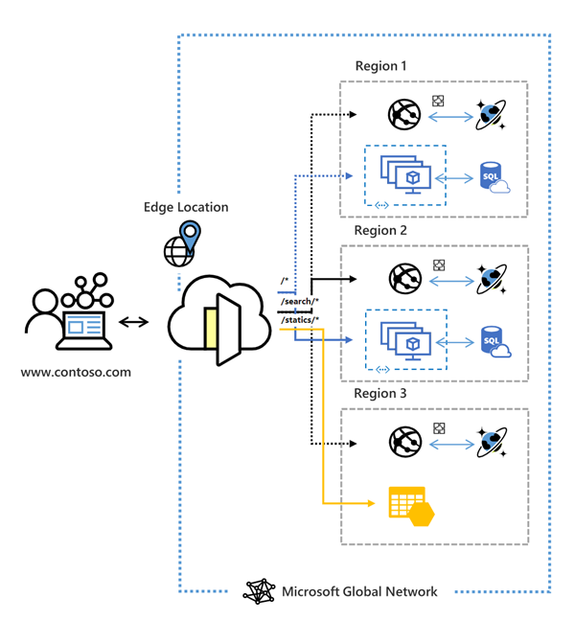
What is Azure Front Door
Global, scalable entry-point that uses the Microsoft global edge network to create fast, secure, and widely scalable web applications
Accelerated application performance by using split TCP-based anycast protocol
Intelligent health probe monitoring for backend resources
URL-path based routing for requests
Enables hosting of multiple websites for efficient application infrastructure
Notes:
Azure Front Door is a global, scalable entry-point that uses the Microsoft global edge network to create fast, secure, and widely scalable web applications. With Front Door, you can transform your global consumer and enterprise applications into robust, high-performing personalized modern applications with contents that reach a global audience through Azure.
Front Door works at Layer 7 (HTTP/HTTPS layer) using anycast protocol with split TCP and Microsoft's global network to improve global connectivity. Based on your routing method you can ensure that Front Door will route your client requests to the fastest and most available application backend. An application backend is any Internet-facing service hosted inside or outside of Azure. Front Door provides a range of traffic-routing methods and backend health monitoring options to suit different application needs and automatic failover scenarios. Like Traffic Manager, Front Door is resilient to failures, including failures to an entire Azure region.
Azure Front Door enables internet-facing application to:
Build and operate modern internet-first architectures that have dynamic, high-quality digital experiences with highly automated, secure, and reliable platforms.
Accelerate and deliver your app and content globally at scale to your users wherever they're creating opportunities for you to compete, weather change, and quickly adapt to new demand and markets.
Intelligently secure your digital estate against known and new threats with intelligent security that embrace a Zero Trust framework.
What is the difference between Azure Front Door and Azure Application Gateway?
While both Front Door and Application Gateway are layer 7 (HTTP/HTTPS) load balancers, the primary difference is that Front Door is a global service whereas Application Gateway is a regional service. Front Door can load balance between your different scale units/clusters/stamp units across regions, and Application Gateway allows you to load balance between your VMs/containers that is within the scale unit.

Slide 27



Azure Front Door Standard and Premium
Azure CDN
Azure Front Door
Azure Front Door Standard and Premium SKU
Azure WAF
Azure Front Door Standard SKU is:
Content delivery optimized
Offering both static and dynamic content acceleration
Global load balancing
SSL offload
Domain and certificate management
Enhanced traffic analytics
Basic security capabilities
Azure Front Door Premium SKU builds on capabilities of Standard SKU, and adds:
Extensive security capabilities across WAF
BOT protection
Private Link support
Integration with Microsoft Threat Intelligence and security analytics.
Notes:
Azure Front Door is offered in 2 different tiers, Azure Front Door Standard and Azure Front Door Premium. Azure Front Door Standard and Premium tier combines capabilities of Azure Front Door (classic), Azure CDN Standard from Microsoft (classic), and Azure WAF into a single secure cloud CDN platform with intelligent threat protection.
Azure Front Door tier comparison | Microsoft Docs https://docs.microsoft.com/azure/frontdoor/standard-premium/tier-comparison#feature-comparison-between-tiers
Azure Front Door Standard/Premium SKUs combines capabilities of Azure Front Door, Azure CDN Standard from Microsoft, Azure WAF into a single secure cloud CDN platform with intelligent threat protection.

Slide 28
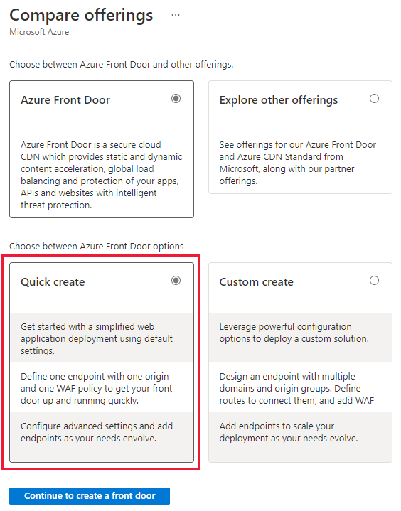
Create a Front Door in the Azure portal
Quick Create or Custom Create
Select between Standard and Premium tier
Globally unique endpoint name
Select Origin type, for example: App service or App Gateway
Notes:
Consider demonstrating creating a Front Door in the Azure portal. This is the NEW Azure Front Door deployment option. To see Classic, select “Explore other offerings”

Slide 29
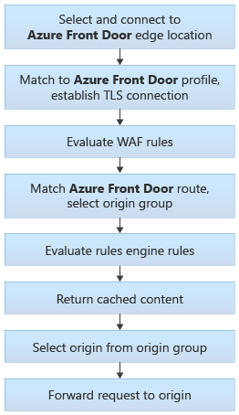
Configure routing and redirection rules
Routing architecture overview
Front Door matches the incoming request to the left-hand side of the route. The right-hand side defines how Front Door processes the request
Incoming match (left-hand side)
HTTP Protocols (HTTP/HTTPS)
Hosts (for example, www.foo.com, *.bar.com)
Paths (for example, /*, /users/*, /file.gif)
Route data (right-hand side)
The decision of how to process the request, depends on whether caching is enabled or not for the specific route
Notes:
Front Door traffic routing takes place over multiple stages. First, traffic is routed from the client to Front Door. Then, Front Door uses your configuration to determine the origin to send the traffic to. The Front Door web application firewall, routing rules, rules engine, and caching configuration all affect the routing process.
The image on the right illustrates the routing architecture.
A Front Door routing rule configuration is composed of two major parts: a "left-hand side" and a "right-hand side". Front Door matches the incoming request to the left-hand side of the route. The right-hand side defines how Front Door processes the request.
Azure Front Door provides web application firewall capabilities to help protect your web applications from exploits and vulnerabilities. Managing security for your applications can be challenging because web applications are increasingly targeted.
Azure Front Door operates at the network's edge, close to potential attacks. This helps prevent attacks before they can enter your network. Azure Front Door's web application firewall is based on policies you can associate with one or more instances of Azure Front Door.
These firewall policies consist of:
Managed rule sets, which are a collection of preconfigured rules.
Custom rules that you can configure.

Slide 30
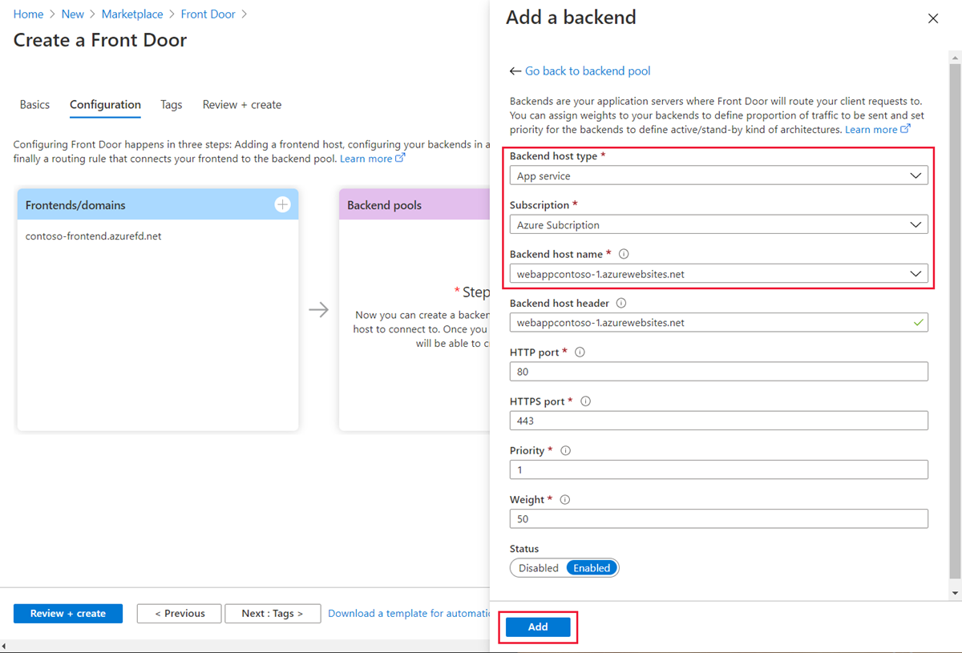
Configure back-end targets
Backend host type
Subscription and Backend host name
Backend host header
Priority and Weight
Notes:
THIS IS THE CLASSIC FRONT DOOR Back-end configuration
Backend host type. The type of resource you want to add. Front Door supports autodiscovery of your app backends from app service, cloud service, or storage. If you want a different resource in Azure or even a non-Azure backend, select Custom host.
Subscription and Backend host name. If you haven't selected Custom host for backend host type, select your backend by choosing the appropriate subscription and the corresponding backend host name in the UI.
Backend host header. The host header value sent to the backend for each request.
Priority. Assign priorities to your different backends when you want to use a primary service backend for all traffic. Also, provide backups if the primary or the backup backends are unavailable.
Weight. Assign weights to your different backends to distribute traffic across a set of backends, either evenly or according to weight coefficients.

Slide 31
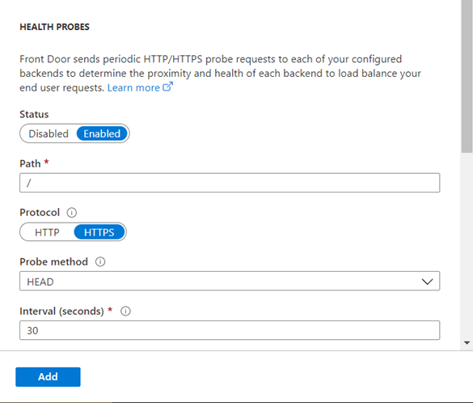
Configure health probes
Front Door supports the following HTTP methods for sending the health probes:
GET: The GET method means retrieve whatever information (in the form of an entity) is identified by the Request-URI.
HEAD: The HEAD method is identical to GET except that the server MUST NOT return a message-body in the response. For new Front Door profiles, by default, the probe method is set as HEAD.
Notes:
This is the classic Front Door heath Probe configuration
To determine the health and proximity of each backend for a given Front Door environment, each Front Door environment periodically sends a synthetic HTTP/HTTPS request to each of your configured backends. Front Door then uses these responses from the probe to determine the "best" backend resources to route your client requests.
Front Door supports sending probes over either HTTP or HTTPS protocols. These probes are sent over the same TCP ports configured for routing client requests, and cannot be overridden.
Azure Front Door uses the same three-step process below across all algorithms to determine health.
Exclude disabled backends.
Exclude backends that have health probes errors:
This selection is done by looking at the last n health probe responses. If at least x are healthy, the backend is considered healthy.
n is configured by changing the SampleSize property in load-balancing settings.
x is configured by changing the SuccessfulSamplesRequired property in load-balancing settings.
For the sets of healthy backends in the backend pool, Front Door additionally measures and maintains the latency (round-trip time) for each backend.

Slide 32
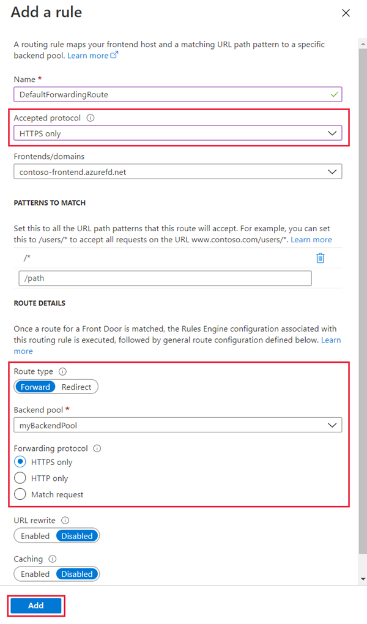
Secure Front Door with SSL and end-to-end SSL encryption
Create HTTP to HTTPS redirect rule
Create a routing rule for HTTP to HTTPS redirect
Add routing rule to handle the HTTPS traffic
On the Route Details section, set the Route Type to Forward.
Notes:
Classic Front Door Configuration
Does Azure Front Door also support re-encryption of traffic to the backend?
Yes, Azure Front Door supports TLS/SSL offload, and end to end TLS, which re-encrypts the traffic to the backend. In fact, since the connections to the backend happen over its public IP, it is recommended that you configure your Front Door to use HTTPS as the forwarding protocol.
Create a Front Door with HTTP to HTTPS redirection using the Azure portal | Microsoft Docs

Slide 33
Demonstration – deploy Azure Front Door
Create two instances of a web app
Create a Front Door for your application
View Azure Front Door in action
Notes:
Quickstart: Set up high availability with Azure Front Door Service - Azure portal | Microsoft Docs

Slide 34
Summary – Design and Configure Azure Front Door
Check your knowledge
Microsoft Learn Modules (docs.microsoft.com/Learn)
Azure Front Door | Microsoft Docs
Tutorial: Scale and protect a web app by using Azure Front Door and Azure Web Application Firewall (WAF) | Microsoft Docs

Slide 35
Lesson 05: Exercise: create a Front Door for a highly available web application

Slide 36
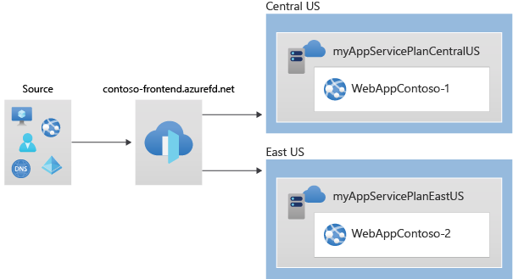
Exercise: create a Front Door for a highly available web application
Task 1: Create two instances of a web app
Task 2: Create a Front Door for your application
Task 3: View Azure Front Door in action
Task 4: Clean up resources
Notes:
AZ-700-Designing-and-Implementing-Microsoft-Azure-Networking-Solutions/6-exercise-create-front-door-for-highly-available-web-application-using-azure-port.md at master · MicrosoftLearning/AZ-700-Designing-and-Implementing-Microsoft-Azure-Networking-Solutions (github.com)
https://microsoftlearning.github.io/AZ-700-Designing-and-Implementing-Microsoft-Azure-Networking-Solutions/Instructions/Exercises/M05-Unit%206%20Create%20a%20front%20door%20for%20a%20highly%20available%20web%20application%20using%20the%20Azure%20portal.html

Slide 37
Summary – deploy Front Door
Check your knowledge
Microsoft Learn Modules (docs.microsoft.com/Learn)
Quickstart: Set up high availability with Azure Front Door Service - Azure portal | Microsoft Docs

Slide 38
End of presentation

